Slide 1
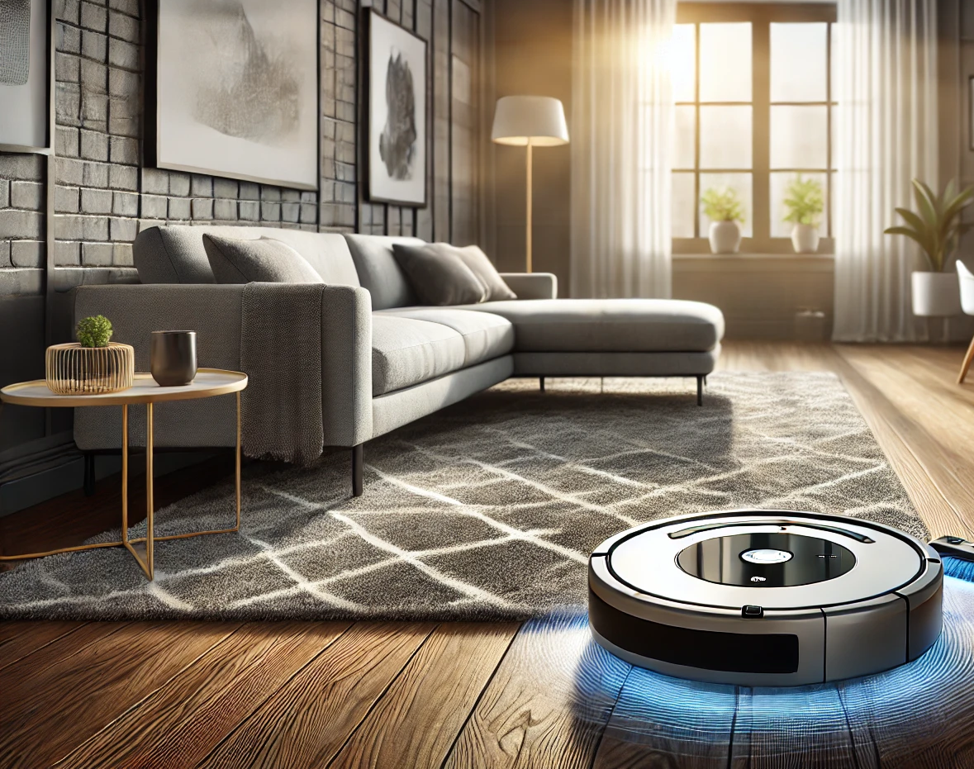
Autonomous Floor Cleaners – A Focus on Roomba Robots
By Swaroop Senadhipan B.

Slide 2
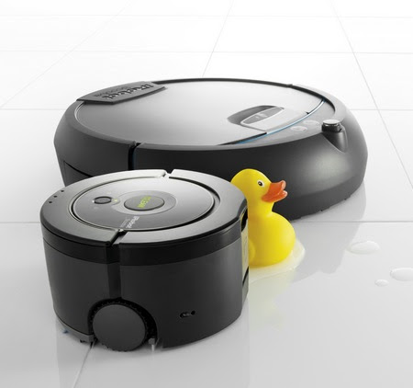
INTRODUCTION
Roomba is a series of autonomous robotic floor cleaners developed by iRobot. These bots can clean up the floors using advanced sensing systems and navigation technologies with their AI-powered algorithms.
Why Roomba?
Pioneer in the field of autonomous floor cleaning, continuous innovation.
Explores mobile robot locomotion, sensing, and AI systems in a domestic setting.
Represents a practical and widely adopted application of mobile robotics.
This Photo by Unknown Author is licensed under CC BY-SA

Slide 3
MAIN FEATURES OF ROOMBA BOT
Automated cleaning of floors in residential and commercial spaces.
Vacuuming and debris collection.
Surface adaptation (carpets, tiles, hardwood).
Scheduling and autonomous docking for recharging.

Slide 4
ROBOT LOCOMOTION MECHANISM
Locomotion Design:
Wheeled movement for maneuverability across various floor types.
Low-profile design for reaching under furniture.
Adaptability:
Rubberized wheels for grip on multiple surfaces.
Brush mechanisms to agitate dirt and hair from carpets.

Slide 5
SENSORS USED
Infrared Sensors: Detect obstacles and navigate around them.
Cliff Sensors: Prevent falls from stairs or ledges.
Dirt Detection Sensors: Focus on heavily soiled areas.
Mapping Sensors: LiDAR and cameras for real-time mapping and efficient path planning.
Feature Highlight: iRobot's vSLAM (Visual Simultaneous Localization and Mapping) for enhanced room mapping.

Slide 6
Control and AI Algorithms
Navigation and Control:
Algorithm-driven path planning for systematic cleaning.
Randomized movement in older models vs. structured cleaning in advanced models.
AI Integration:
Room mapping and area-based cleaning customization.
Machine learning to adapt to user preferences and optimize performance over time.
Comparison:
Entry-level models: Reactive navigation and simpler controls.
High-end models: AI-based mapping, voice control integration, and smart home compatibility.

Slide 7
Comparison of Roomba with Similar Bots
Feature | Roomba (iRobot) | Roborock (e.g., S8 Pro Ultra) | Dyson 360 Heurist
Navigation System | vSLAM + Infrared Sensors | LiDAR + Structured Navigation | 360° Vision Camera
Cleaning Mechanism | Dual Multi-Surface Brushes + Vacuum | Main Roller Brush + Vacuum | Helical Brush Bar + Vacuum
Mapping Technology | Advanced Room Mapping (vSLAM) | Precise 3D Mapping with LiDAR | 360° Real-Time Mapping
Battery Life | ~120 minutes | ~180 minutes | ~75 minutes
Obstacle Detection | Reactive Sensor Technology | Obstacle Avoidance (AI-powered) | Minimal Obstacle Avoidance
Dust Bin Capacity | ~0.5 liters | ~0.4 liters | ~0.33 liters
Special Features | Self-Emptying Dock (high-end models) | Mop + Vacuum Combo | High Suction Power (2000+ Pa)
Price Range | $200–$1,400 | $300–$1,500 | ~$1,000

Slide 8
Issues and Challenges
Handling cluttered spaces and small objects (e.g., cables, toys).
Navigation in low-light or reflective floor conditions.
Managing battery life for large spaces.
Avoiding damage to delicate objects or carpets with fringes.
Hair and debris tangling in brushes.
Regular cleaning of sensors and dustbins.

Slide 9
Benefits of Roomba Robots
Efficiency:
Saves time and effort with scheduled, automated cleaning.
Adaptability:
Handles multiple surface types in a single session.
User Convenience:
Smart home integration (Amazon Alexa, Google Assistant).
Self-emptying features in premium models.

Slide 10
Limitations and Improvements
Limitations:
High initial cost for premium models.
Challenges in cleaning stairs or elevated surfaces.
Ongoing Developments:
AI for object recognition (e.g., avoiding pet waste).
Improved battery life and faster cleaning algorithms.

Slide 11
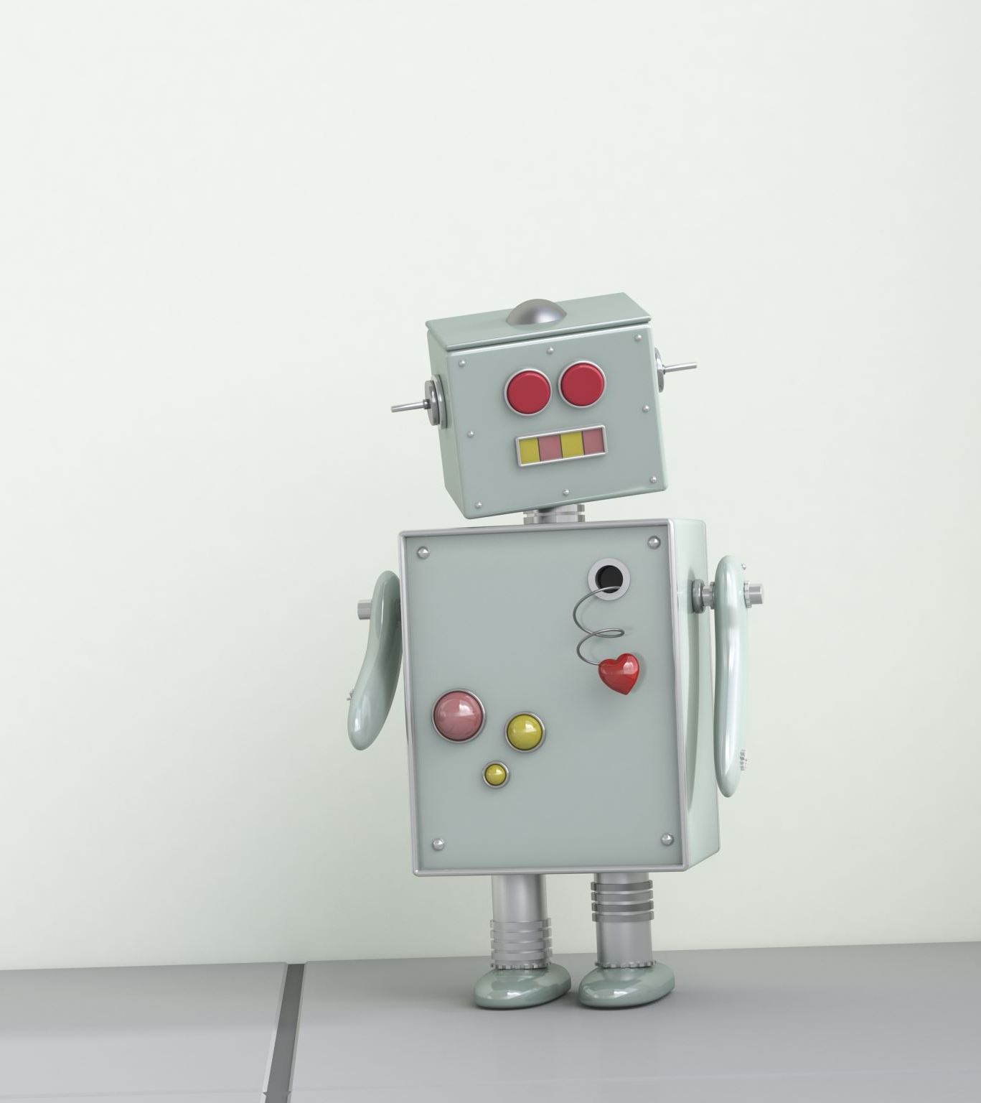
Conclusion
Roomba robots exemplify the progress in autonomous floor cleaning, balancing convenience, adaptability, and technological sophistication.
Integration with broader home automation systems.
Use of robotics for broader household cleaning tasks.

Slide 12
REFERENCES
Tribelhorn, B. and Dodds, Z., 2007, April. Evaluating the Roomba: A low-cost, ubiquitous platform for robotics research and education. In Proceedings 2007 IEEE International Conference on Robotics and Automation (pp. 1393-1399). IEEE.

Slide 13

Q&A

